Slide 1
Digital Fundamentals
CHAPTER 6 Functions of Combinational Logic

Slide 2
Chapter Outline
6–1 Half and Full Adders
6–2 Parallel Binary Adders
6–3 Ripple Carry and Look-Ahead Carry Adders
6–4 Comparators
6–5 Decoders
6–6 Encoders
6–7 Code Converters
6–8 Multiplexers (Data Selectors)
6–9 Demultiplexers
6–10 Parity Generators/Checkers
6–11Troubleshooting Applied Logic

Slide 3
Comparators
The basic function of a comparator is to compare the magnitudes of two binary quantities
In its simplest form, a comparator circuit determines whether two numbers are equal.

Slide 4
Comparators
1-Bit Comparator
2-Bit Comparator
4-Bit Comparator

Slide 5
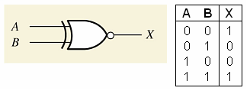
Comparators
1-Bit Comparator - Exclusive NOR
The output is 1 when the inputs are equal

Slide 6
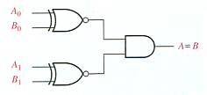
Comparators
2-Bit Comparator
The output is 1 when A₀ = B₀ AND A₁ = B₁

Slide 7
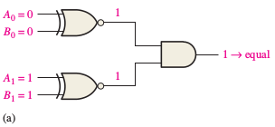
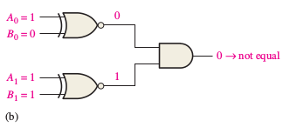
Example 6-5: Comparators
Apply each of the following sets of binary numbers to the comparator inputs in Figure 6–20, and determine the output by following the logic levels through the circuit.
(a) 10 and 10 (b) 11 and 10

Slide 8
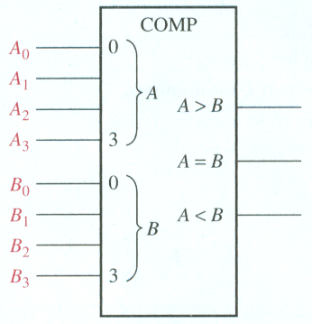
Inequality: Comparators
4-Bit Comparator
One of three outputs will be HIGH:
A greater than B (A > B)
A equal to B (A = B)
A less than B (A < B)
To determine an inequality of binary numbers A and B, you first examine the highest-
order bit in each number. The following conditions are possible:
1. If A3 = 1 and B 3 = 0, number A is greater than number B.
2. If A3 = 0 and B 3 = 1, number A is less than number B.
3. If A3 = B 3 , then you must examine the next lower bit position for an inequality.

Slide 9
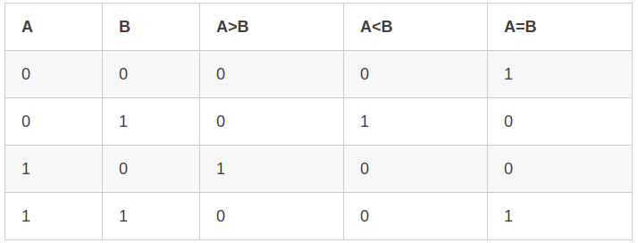
Inequality: Comparators
1-Bit Comparator
One of three outputs will be HIGH:
A greater than B (A > B)
A equal to B (A = B)
A less than B (A < B)

Slide 10
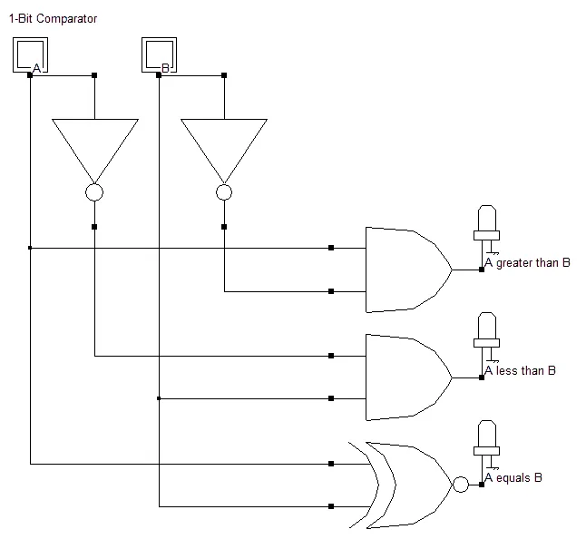
Inequality: Comparators
1-Bit Comparator
One of three outputs will be HIGH:
A greater than B (A > B)
A equal to B (A = B)
A less than B (A < B)

Slide 11
Inequality: Comparators
2-Bit Comparator

Slide 12
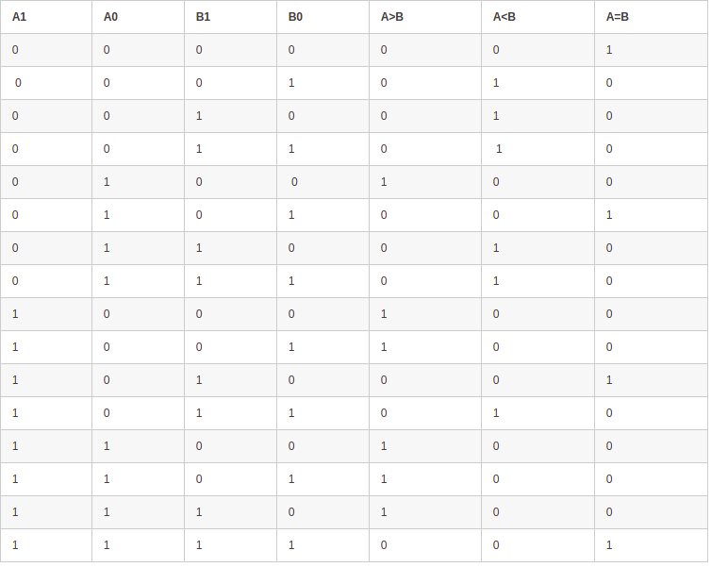
Inequality: Comparators
2-Bit Comparator

Slide 13
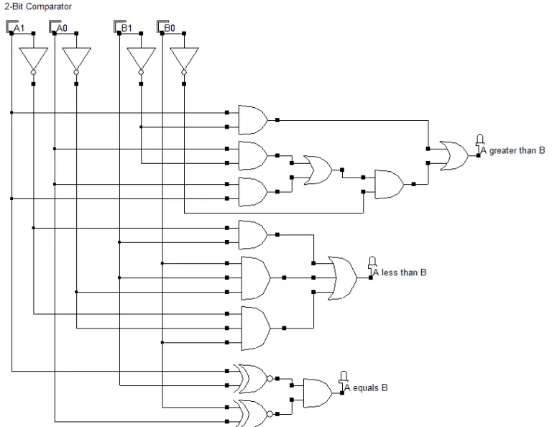
Inequality: Comparators
2-Bit Comparator

Slide 14
Inequality: Comparators
2-Bit Comparator

Slide 15
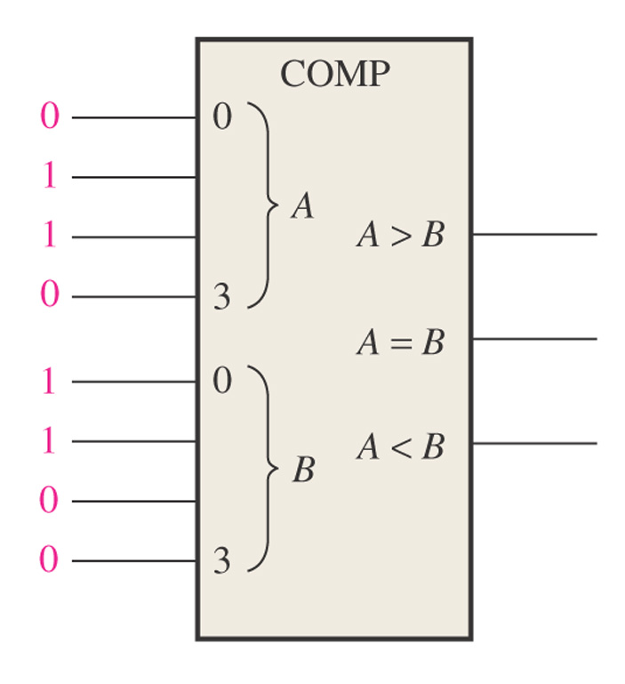
Figure 6–23 What are the outputs for the given inputs?
1
0
0
A B 0110 > 0011 YES 0110 = 0011 NO 0110 < 0011 NO

Slide 16
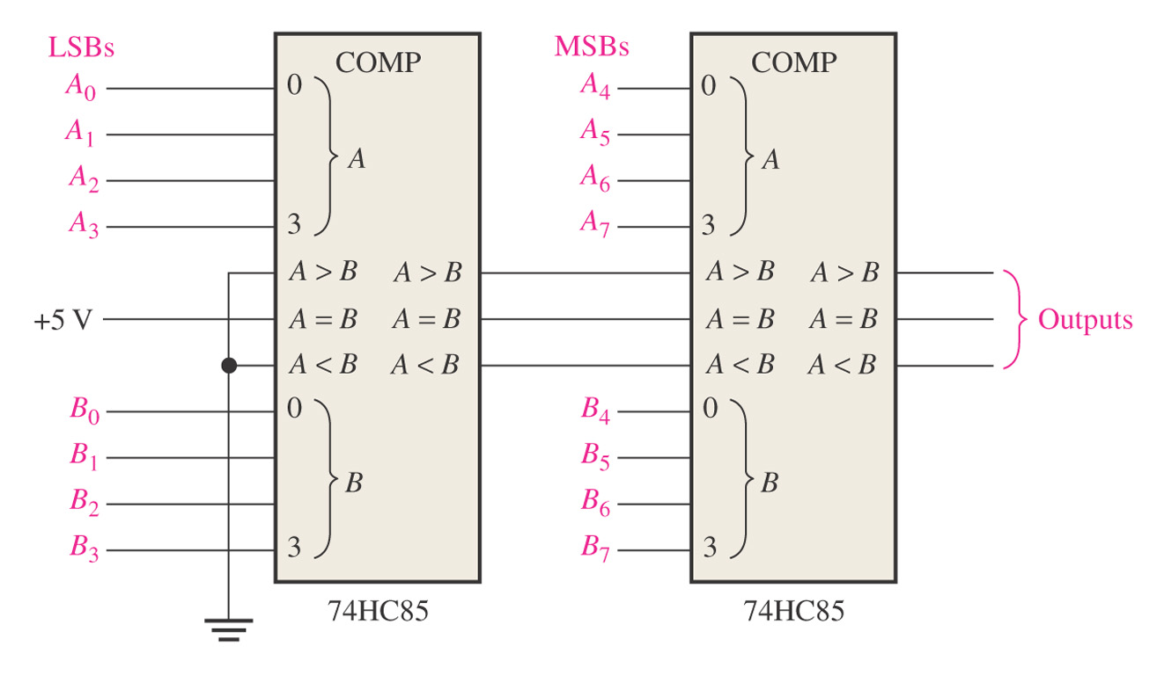
Figure 6–25 An 8-bit magnitude comparator using two 74HC85s.
Lowest-order comparator must have a LOW on A > B and A < B input and a HIGH on A = B input.

Slide 17
Decoders
n inputs-to-2^{n} outputs
Binary decoder
4-bit decoder
BCD-to-decimal decoder
BCD-to-7-segement decoder

Slide 18
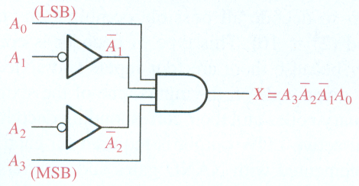
Decoders
Suppose we want to know when a binary 1001 occurs on the inputs of a digital circuit.
We can use a Decoder for this function.
Binary decoder
The output is 1 only when:
A₀ = 1
A₂ = 0
A₃ = 0
A₄ = 1
This is only one of an infinite number of examples

Slide 19
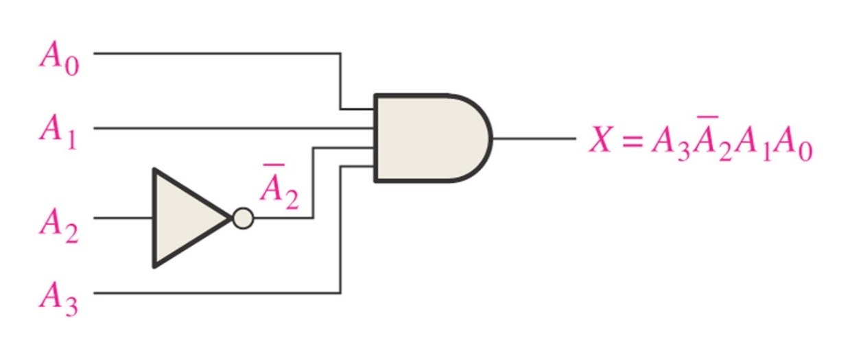
Determine the logic required to decode the binary number 1011 by producing a HIGH level on the output. LSB = A₀ (right most)
A₀ = 1, A₁ = 1, A₂ = 0, A₃ = 1
X = A₃A₂A₁A₀

Slide 20
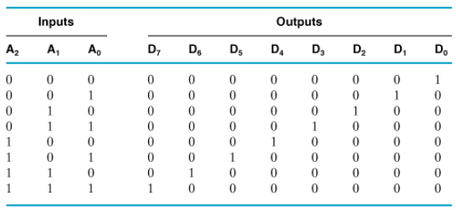
Truth Table for 3-to-8 Line Decoder

Slide 21
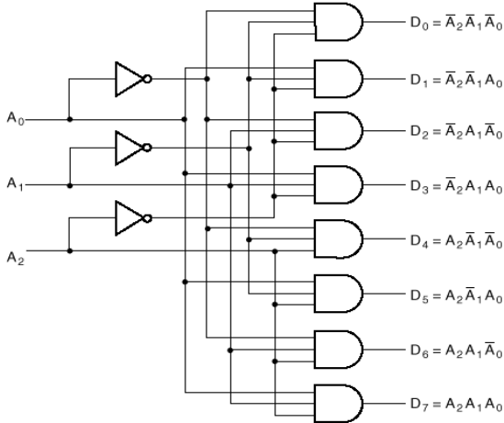
3-to-8 Line Decoder

Slide 22
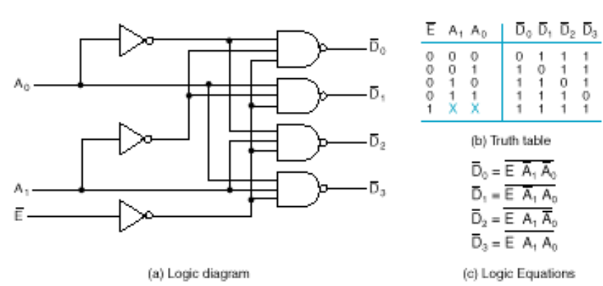
2-to-4 Line Decoder

Slide 23
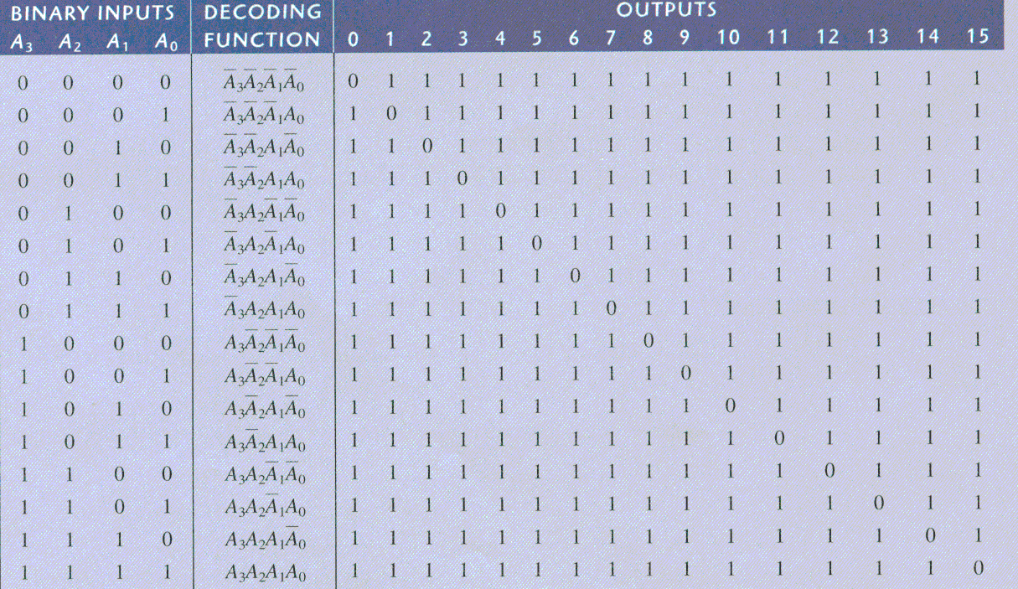
Decoders
4-bit decoder (4 line to 16 line decoder or 1 of 16 decoder)
Logic Diagram

Slide 24
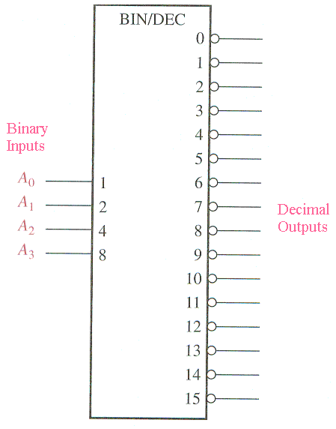
Decoders
4-bit decoder
Binary inputs
Truth Table

Slide 25
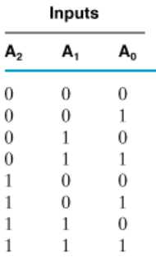
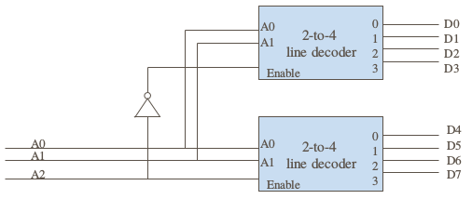
3-to-8 Line Decoder using 2-to-4 Decoder

Slide 26
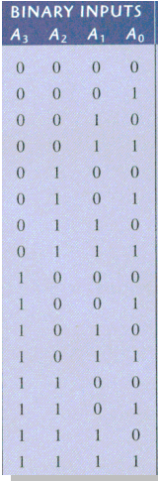
4-to-16 Line Decoder using 2-to-4 Decoder
A1
A0
A3
A2

Slide 27
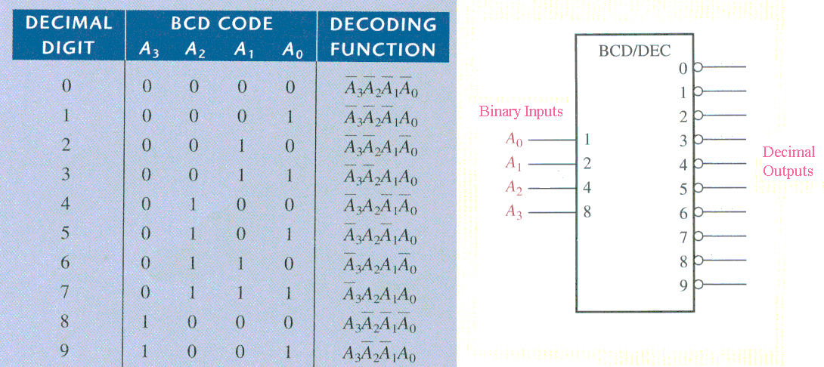
Decoders
BCD-to-decimal decoder
If 0011 is input, then output 3 is low and all other outputs are high Active Low output since bubbles on outputs.

Slide 28
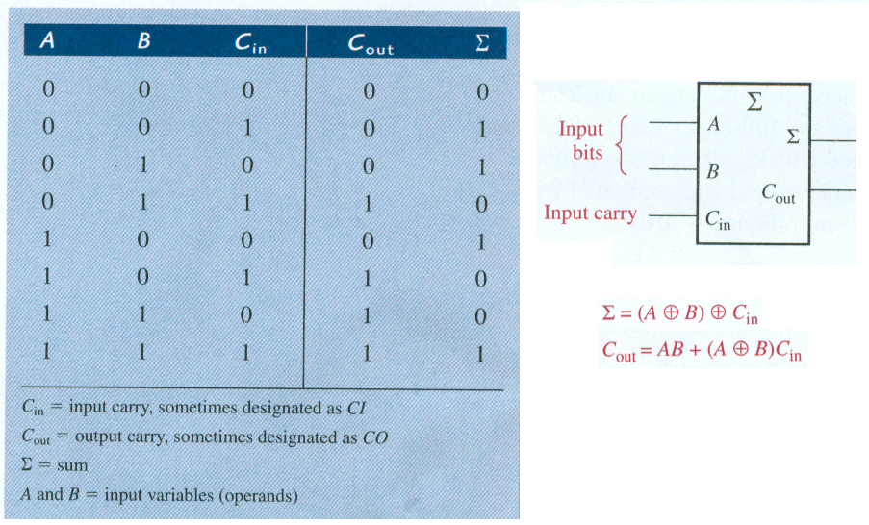
TASKS: Decoders
BCD-to-7-segement decoder

Slide 29
Encoders
“reverse” decoder function
The process of converting from familiar symbols or numbers to a coded format is called encoding.
Decimal-to-BCD encoder
8-line-to-3-line encoder

Slide 30
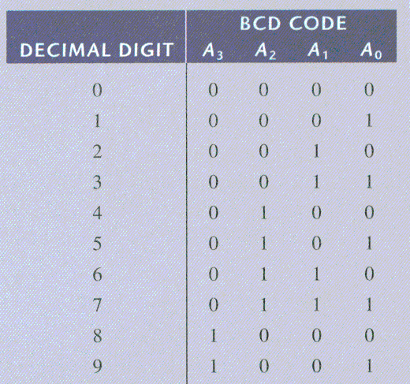
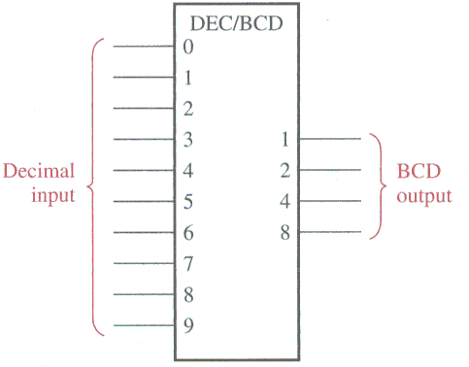
Encoders
Decimal-to-BCD encoder ( 10 inputs, 4 outputs)

Slide 31
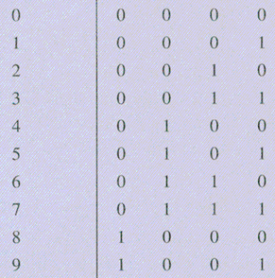
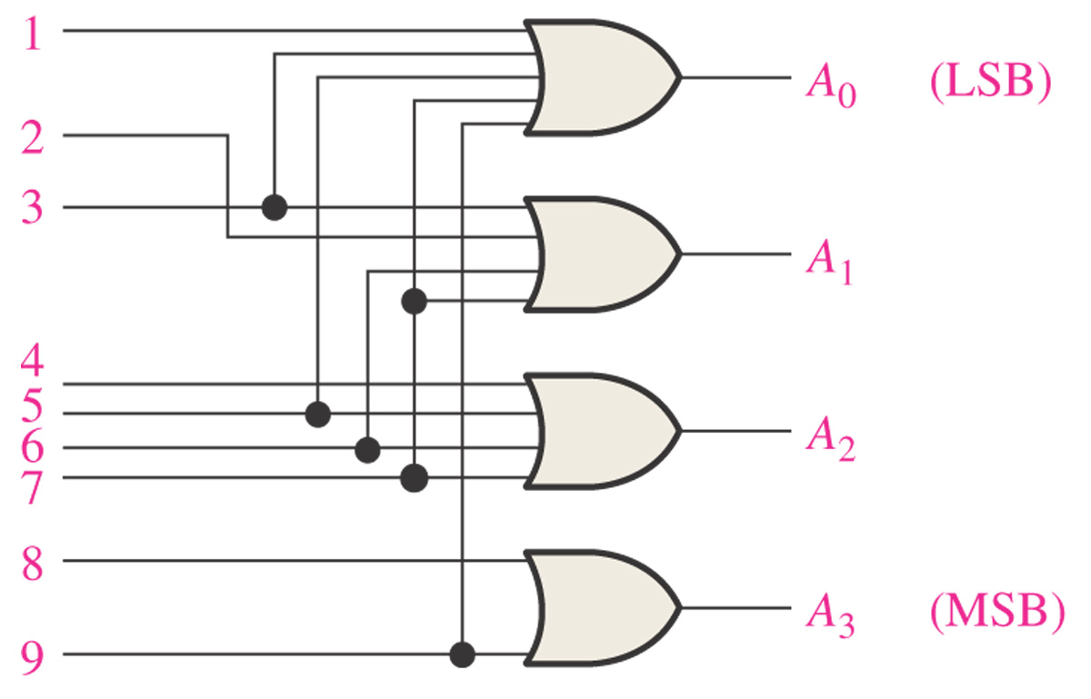
Logic Diagram of Decimal-to-BCD Encoder
A₀ = 1 + 3 + 5 + 7 + 9
A₁ = 2 + 3 + 6 + 7
A₂ = 4 + 5 + 6 + 7
A₃ = 8 + 9

Slide 32
Code Converters
BCD-to-binary conversion
Binary-Gray conversions

Slide 33
Example: BCD
BCD-to-Binary Conversion
One method of BCD-to-binary code conversion uses adder circuits. The basic conversion process is as follows:
1. The value, or weight, of each bit in the BCD number is represented by a binary number.
2. All of the binary representations of the weights of bits that are 1s in the BCD number are added.
3. The result of this addition is the binary equivalent of the BCD number.
A more concise statement of this operation is
The binary numbers representing the weights of the BCD bits are summed to produce the total binary number.

Slide 34
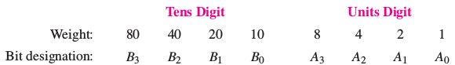
Example: BCD
decimal number 87 can be expressed in BCD as
1000 0111
8 7
The left-most 4-bit group represents 80, and the right-most 4-bit group represents 7. That is, the left-most group has a weight of 10, and the right-most group has a weight of 1. Within each group, the binary weight of each bit is as follows:

Slide 35
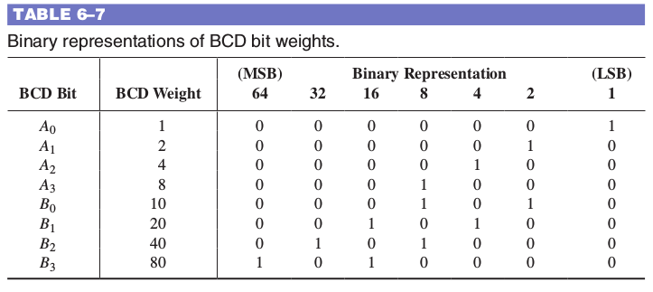
Example: BCD
If the binary representations for the weights of all the 1s in the BCD number are added, the result is the binary number that corresponds to the BCD number.

Slide 36
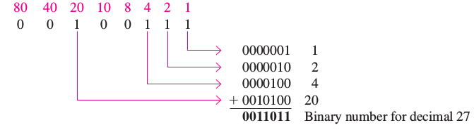
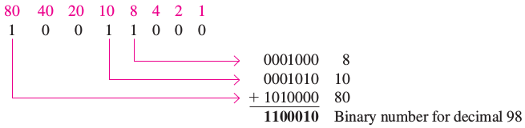
Example: BCD
Convert the BCD numbers 00100111 (decimal 27) and 10011000 (decimal 98) to binary.
Write the binary representations of the weights of all 1s appearing in the numbers, and then add them together.

Slide 37
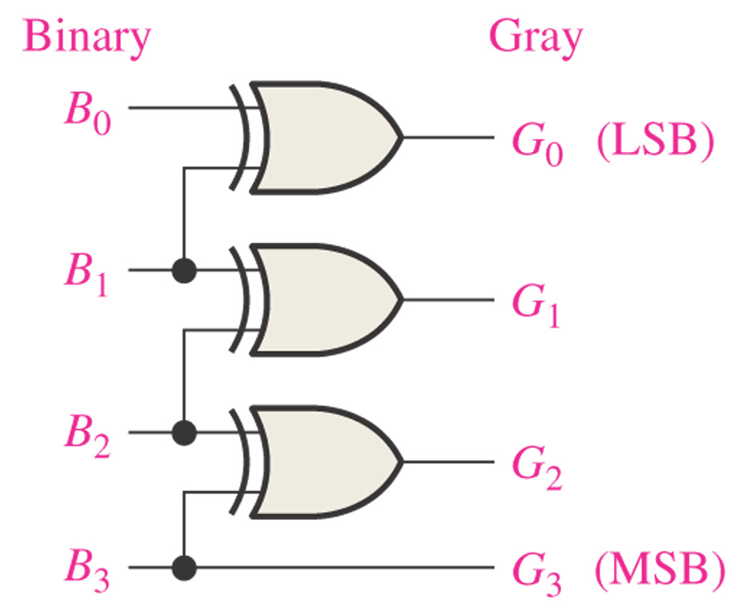
Figure 6–43 Four-bit binary-to-Gray conversion logic.
Convert 1 1 0 0 to Gray
1
1
0
1
0
1
0
1
1
1
0
0

Slide 38
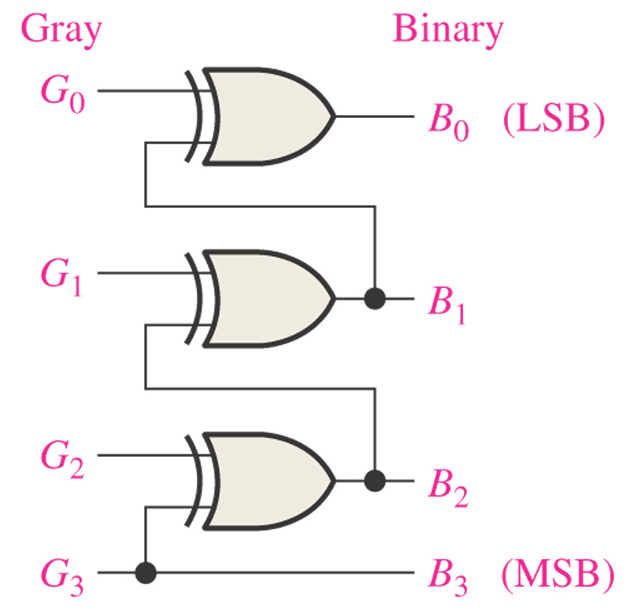
Figure 6–44 Four-bit Gray-to-binary conversion logic.
Convert 1 0 1 0 to Gray
1
1
1
1
0
0
1
0
0
0
1
1
1

Slide 39
Multiplexers (Data Selectors)
Functionality:
Selection of a particular input
Route 1 of N inputs (A) to the output Y
4-input multiplexer
Expanded multiplexers

Slide 40
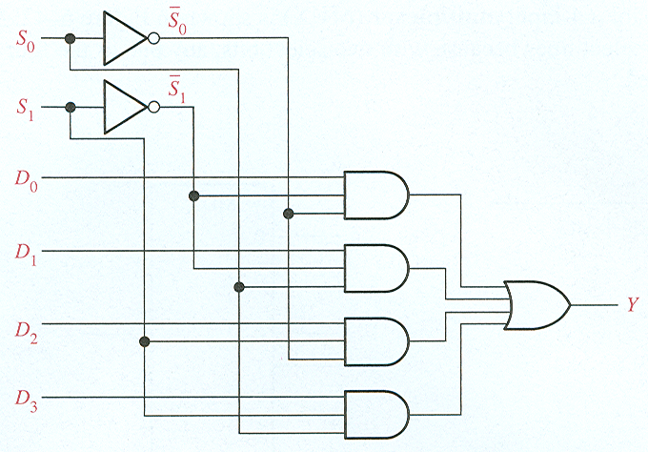
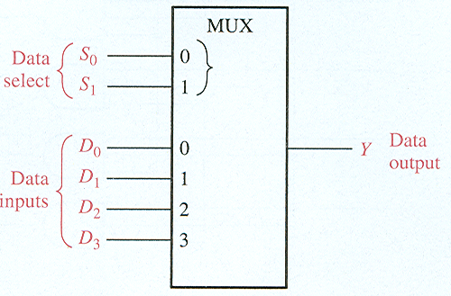
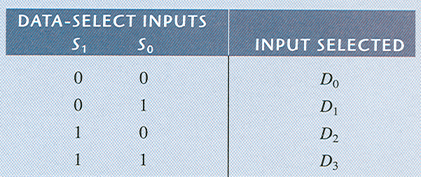
Multiplexers (Data Selectors)
4-input multiplexer
If Data-Select Inputs are 10, then Y = D₂ If D₂ = 0, then Y = 0. If D₂ = 1, then Y = 1.

Slide 41
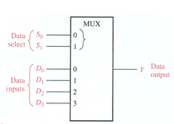
What is the output Y if we have the following inputs?
0 1
1 1
1 0 1 0
1 0 1 0
1
0

Slide 42
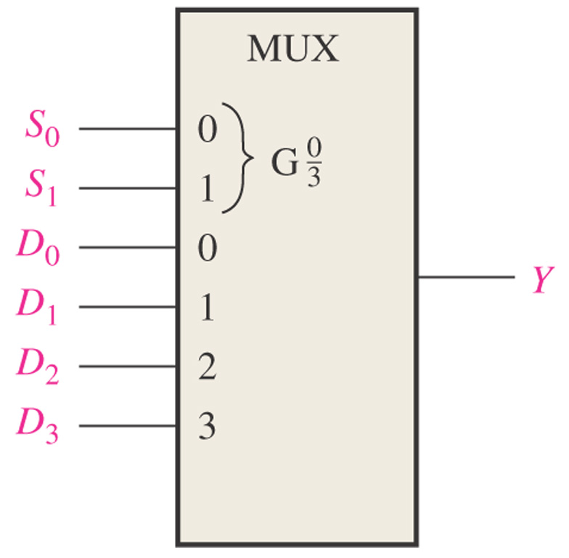
Figure 6–85. Like Problem 28.
If S₀S₁ = 11 and D₃D₂D₁D₀ = 1001, what is the output?
= 1

Slide 43
Demultiplexers
Reverses the multiplexing function.
Sends the data input to the selected output.
Decoders can be demultiplexers.

Slide 44
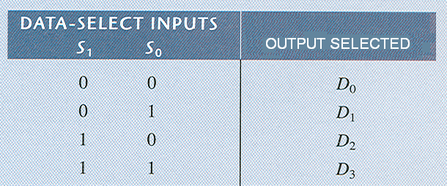
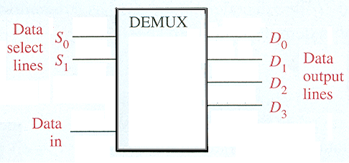
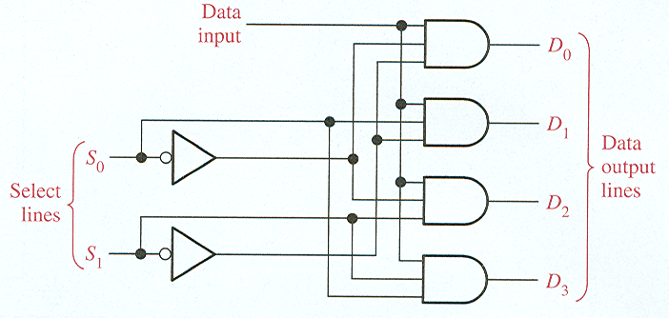
Demultiplexers
2-line-to-4-line demux

Slide 45
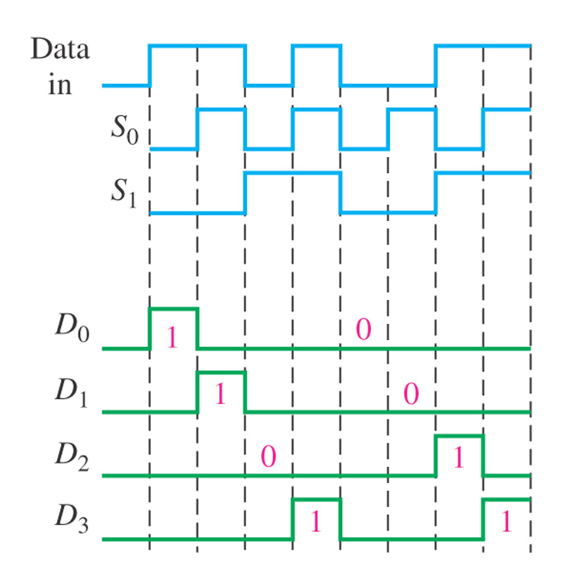
Find the data-output waveforms for the demultiplexer.
S₀ and S₁ select which output line will receive the input data.
If data input is zero, then all outputs will be zero.

Slide 46
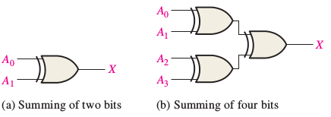
Parity Generators/Checkers
Parity generator/checker
Sum of even number of 1s is always 0. Sum of odd number of 1s is always 1.

Slide 47
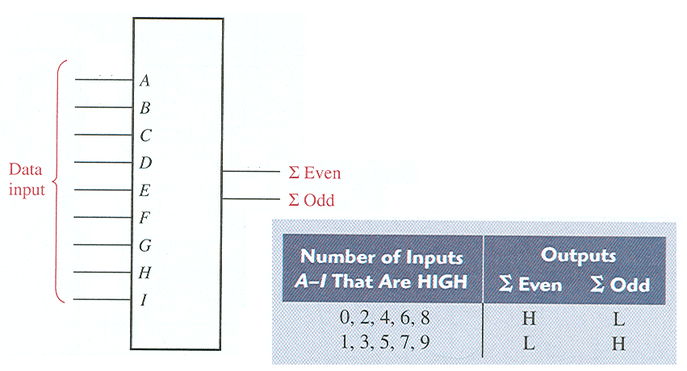
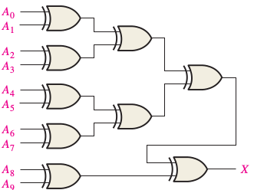
Parity Generators/Checkers
Parity generator/checker
even parity checker use even bits
even parity generator, the parity bit is taken at the sigma Odd output because this output is a 0
74HC280

